Slide 1

Indonesians Behavior in Bank Transaction
By
Raqi Akbar Robbani

Slide 2
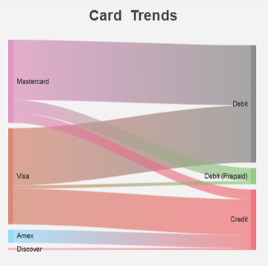
Card usage trends
Indonesians most popular card brands are Mastercard and Visa. Only few of them have Amex and Discover. Majority of Mastercard users are using debit. While the few similar portions distributed on debit (prepaid) and credit card. On the other hand, Visa users in credit and debit are nearly equal.

Slide 3
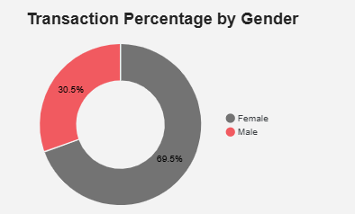
User segmentation
Most of the users are female, that dominated in the debit and credit users. Meanwhile the debit (prepaid) user’s gender are almost equal.

Slide 4
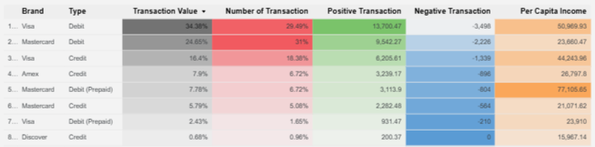
User segmentation
The highest transaction comes from Mastercard Debit, but the highest average value of transaction comes from Visa Debit. It might shows that the Mastercard Debit users has higher income than Visa Debit. Although the highest income actually comes from the Mastercard Prepaid Debit users.

Slide 5
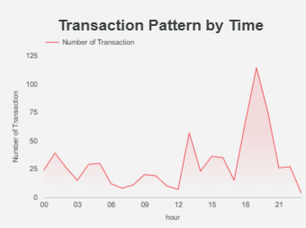
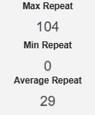
Transaction pattern
The transactions peak the most at 7 pm and slightly drop at 8 pm but dropped drastically at night. On average, every user has only repeated the transactions using the same card 29 times.

